Slide 1
Managing Legal Hurdles and Employee Relations During COVID-19
Columbia Chamber - Small Business Breakout & Northeast Connection
November 19, 2021
Presenter: D. Michael Henthorne (Columbia, SC)

Slide 2
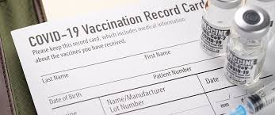
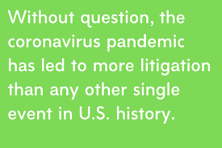
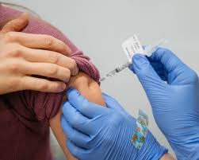
Managing Legal Issues as an Employer Has Never Been More Challenging

Slide 3
Vaccines

Slide 4
Why?
Political views
Socioeconomic views
Religious views
Misinformation
Evolving information
Ambivalence
Fear
Distrust
Overwhelm

Slide 5
The Elephant in the Room
For more than a year, employers have been asking the question:
“Can we require employees to be vaccinated against COVID-19?”
Generally, the answer is - and has been - yes.
Some employers were reluctant.

Slide 6
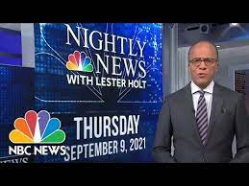
Then came September 9, 2021…

Slide 7
The Biden Vaccine Plan – What We Know
President Biden directed OSHA to develop an Emergency Temporary Standard (ETS) that would:
Require employers with 100 or more employees to ensure their workforce is either:
Fully vaccinated; or
Tested for COVID-19 at least once per week and produce a negative test result in order to come to work
Employers will have to provide paid time off for employees to get vaccinated or to recover if they become ill post-vaccination
Employees can seek disability accommodations or assert religious objections
The White House estimates that this will impact 80 million workers
Once issued, an ETS expires in six months (unless made permanent)

Slide 8
The Biden Vaccine Plan – What We Don’t Know
When the ETS will be issued
What the timeline for getting vaccinated will be
Whether employers will be required to pay for COVID-19 tests
What proof of vaccination will be accepted
Will employees waiting for a COVID-19 test result under the ETS be eligible to collect unemployment benefits
How “employer” will be defined and how the number of employees will be counted

Slide 9
What We Think is Likely
Expect the ETS to be announced in October with 60 to 90 days to implement
Expect the ETS to be challenged in court
It’s possible that a U.S. district court judge in a conservative district will issue a temporary restraining order blocking the ETS
OSHA will likely use current DOL definitions of “employer”
Employers will probably have to pay for the COVID-19 testing unless the ETS expressly states otherwise
Copies of vaccination cards will likely be sufficient proof of vaccination

Slide 10
Disability Exemption (ADA)
Recent EEOC guidance makes clear that employers may not force compliance on employees who have disabilities precluding vaccination unless the employer can demonstrate that the employee poses a direct threat to the health and safety of the employee or others in the workplace.
The updated guidance explains that employers should conduct such an assessment based “on a reasonable medical judgment that relies on the most current medical knowledge about COVID-19.”

Slide 11
Disability Exemption (ADA)
While the guidance provides employers with helpful resource references, the EEOC confirms that employers should follow the same interactive process that they do with other disability accommodation requests.

Slide 12
Religious Exemption (Title VII)
The EEOC notes that such requests may come in the context of seeking an exemption from a vaccine requirement altogether or an accommodation in seeking the ability to receive an alternative version of the COVID-19 vaccine that is not objectionable on religious grounds (or waiting until such an alternative becomes available).

Slide 13
Religious Exemption (Title VII)
The EEOC recommends that “the employer should ordinarily assume that an employee’s request for religious accommodation is based on a sincerely held religious belief, practice, or observance.”
However, if an employer is aware of facts that would create an objective basis on which to question “the religious nature or the sincerity” of a belief, practice, or observance, “the employer would be justified in requesting additional supporting information.”

Slide 14
Are You a Government Contractor?
The Biden administration is moving swiftly to incorporate the requirements of Executive Order (EO) 14042, “Ensuring Adequate COVID Safety Protocols for Federal Contractors,” into new and existing contracts.
EO 14042 covers “contracts and contract-like instruments” with the federal government that are (a) for services or construction or have certain connections with federal property; and (b) valued above the government’s “simplified acquisition threshold,” which is $250,000 in most cases.

Slide 15
If so, there is a sense of urgency
Covered employees must be fully vaccinated by December 8, 2021
According to the guidance, this means being two weeks past the second/only vaccination shot.
Takeaway: employees need to have their second/only shots before Thanksgiving.

Slide 16
What about Vaccination Privacy
Is vaccination status considered private under federal or state law?
Can employees fake their vaccination proof?

Slide 17
Best Practices for Employers re Vaccine Privacy
Treat vaccine records and responses to vaccination questions as confidential medical information.
Consider using a third party to collect the information, and ensure privacy protections are addressed in the contract.
Limit access to and disclosure of vaccine information to persons with a legitimate business need to know.
Consider de-identifying vaccine information and disclosing only aggregate information.
Provide notice and consider requesting consent.

Slide 18
Best Practices for Employers re Vaccine Privacy
Do not maintain vaccine records and responses to vaccination questions in personnel files.
“Lock it up.” Protect access to vaccine information with security precautions
– Lock and key
– Password protection
– Two-factor authentication to access
– Secured server

Slide 19
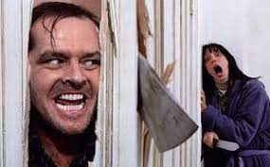
COVID-Related Lawsuits?

Slide 20
There’s So Much More to Consider
Employee Safety
OSHA’s ETS (Due ?)
Staffing
Employee Ghosting
“Bait & Switch”
Unemployment Claims
Avoiding Discrimination, Harassment & Retaliation Claims
Diversity and Inclusion
Managing Leaves of Absence Properly
Wage and Hour Compliance
Increase in Labor Union Interest and Activity
Social Media

Slide 21
We can help…
D. Michael Henthorne
Ogletree, Deakins, Nash, Smoak & Stewart, P.C. First Base Building
2142 Boyce Street, Suite 401
Columbia, SC 29201
Telephone: 803-252-6873 | Mobile: 803-873-5324
michael.henthorne@ogletree.com

Slide 22
Ogletree Deakins Resources
Coronavirus (COVID-19) Resource Center
https://ogletree.com/coronavirus-covid-19-resource-center/

